Slide 1
aOrtic Arch development and its anomalies
Notes:
ERSDFD

Slide 2
Formation of aortic arch

Slide 3
Trunco aortic sac
1
2
3
4
5
7-intersegmental artery
6
Paired dorsal aortae
Notes:
3rd carotid arch
4th systemic arch

Slide 4
Circle of willis
1
2
3
4
7
5
6

Slide 5
3
4
7
6

Slide 6
summary

Slide 10
Anomalies of the arch

Slide 11
Why is it important?
ASSOCIATED with
1)VASCULAR RING
2)CONGENITAL HEART DISEASE
3)CHROMOSOMAL ANOMALY
4)RADIAL ARTERY INTERVENTIONS
5)HAEMODYANAMIC ISSUES

Slide 12
Can be associated with thoracic aortopathy

Slide 13
Misnomer?

Slide 14
ABNORMALITIES
Abnormalities of branching
Abnormalities of arch positon- RAA/Cervical arch
Supernumerary Arch(DAA)
Anomolous origin of PA branches
Interrupted Aortic arch

Slide 15
Arch sidedness

Slide 17
Right aortic arch
Incidence 0.01-0.1% of the general population
Associated with
Truncus arteriosus -50% maximum incidence
Tetrology of fallot -13-34%
vsd
Incidence of right aortic arch in TOF is directly proportional to RVOT obstruction

Slide 19
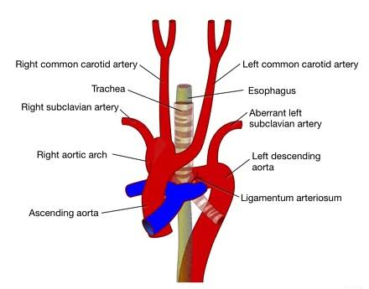
Circumflex Retroesophageal right aortic arch

Slide 20
Right sided aortic arch with mirror image branching
Rarely forms vascular ring
No compressive symptoms
LBC

Slide 21
Associated with CHD in 98% of cases
1)TOF with or without pulmonary atresia
2) Common arterial trunk
Patients with no intra cardiac disease have stenosis or atresia of left pulmonary artery
Notes:
Associated with CHD in 98% of cases

Slide 22
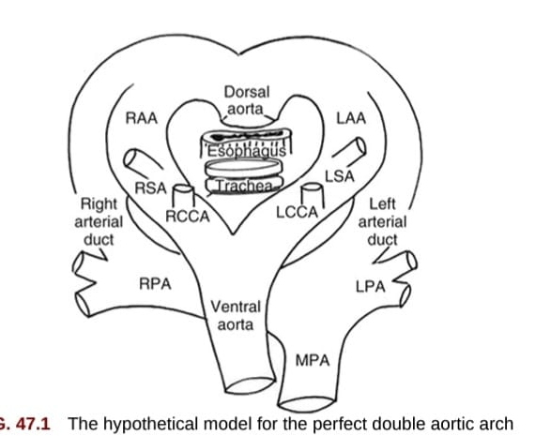
Double aortic arch
Notes:
The ascending aorta bifurcates anteriorly to the trachea and esophagus with 2 arches left and right of TandE.
Left arterial duct is usually predominant
Descending aorta on the left side

Slide 24
Double aorta arch is the tightest form of vascular ring.
REASON:
1)Aortic arches connect the ascending and descending aorta on each side
forming a complete vascular ring
2)Arterial ducts pass between pulmonary artery and the distal part of aortic
arch ,on each side forming an additional vascular ring

Slide 25
In majority of cases , both arches are patent
Right arch is usually larger than left arch
Left arch is dominant in 20% of the cases
Apex of the larger arch is higher than smaller arch

Slide 26
Two third patients have descending aorta in left side
Rest of them have on right side
Neutral position being least common
Segments of one arch may be Atretic
Mostly atretic segments are left sided , distal to the left subclavian artery

Slide 28
Left aortic arch with abberant right subclavian artery
Notes:
Oblique retro esophageal course

Slide 29
It is abnormal regression of right arch between origin of right common carotid and right subclavian.
This leaves distal remnant of right sided aortic arch along with subclavian artery are aberrant artery.

Slide 31
It is the most common anomaly involving the aortic arch
It is usually asymptomatic
This combination forms a partial vascular ring on the left side of trachea and esophagus.

Slide 32
Dysphagia lusoria
This is due to retro esophageal course of right subclavian artery which compresses the esophagus.
10% of adults with this anomaly have the symptoms

Slide 34
axial
Saggital

Slide 35
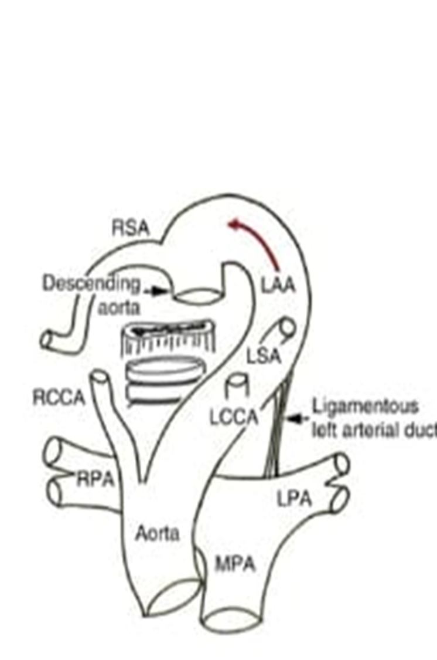
Left aortic arch with abberant right subclavian artery
The ring consist of
Ascending aorta
Left aortic arch
Descending aorta
Distal remnant of right aortic arch
Right arterial duct
Right pulmonary artery
Pulmonary trunk
heart
+ right arterial duct

Slide 36
Left aortic arch with diverticulum of kommerell
Kommerrel’s diverticulum refers to aneurysmal dilatation of descending
aorta at the origin of an abberent subclavian artery

Slide 37
Right aortic arch with abberant left subclavian artery
1)Persistence of right arch and regression of left arch between left common carotid and left subclavian
2)Right arterial duct regressess
Notes:
.
Left subclavian taking its origin from the distal part of left aortic arch.

Slide 39
Left subclavian takes its origin from the distal part of left sided arch
During fetal life, this forms a u shaped vascular loop that encircles trachea and esophagus from behind
They are-
1)Ascending aorta
2)Right aortic arch
3)Distal remnant of left aortic arch
4)Left sided arterial duct and pulmonary trunk
After birth:
Left arterial duct closes
Distal remnant of left aortic arch persist as diverticular outpouching ,called diverticulam of kommerell.
Left subclavian arises from its apex
Notes:
Heart in front

Slide 40
The severity of the esophageal and tracheal compression depends on the size of the diverticulum
The presence of a diverticulum postnatally indicates the presence of arterial ligament between apex and left pulmonary artery

Slide 41
CLINICAL IMPORTANCE:
Aberrant subclavian artery in absence of vascular ring is rarely symptomatic.
In angiography, assessing coronaries via aberrant subclavian artery is difficult.
Aberrant right subclavian artery is usually associated with coarctation.
Aberrant right subclavian artery is distal to the coarctation.
Discrepancy in right and left arm BP.
Chest x-ray - unilateral rib notching

Slide 42
If asymptomatic , abberant subclavian artery in isolation does not
treatment

Slide 43
ABBERANT ORIGIN OF SUBCLAVIAN ARTERY ASSOCIATED WITH DIVERTICULUM OF KOMMEREL
Long term risk of atherosclerosis and torturosity of the abberant subclavian
artery associated with diverticulum of kommerel
Increased risk of rupture of diverticulum-50% patients need surgery
Symptomatic patients , ring can be relieved by division of arterial ligament
Surgical excision should be planned if the aneurysmal segment is more than 50mm in diameter.

Slide 44
Cervical aortic arch
Aortic arch is cervical apex reaches upper mediastinum above
the level of clavicle
It is recognized as a pulsatile mass in supraclavicular fossa or lower neck.
A cervical aortic arch is often associated with tracheal obstruction.
Clinical clue for diagnosis is compression of cervical aortic arch results in loss of femoral pulse.
Upper mediastinum is a small space and many structures are confined to it

Slide 45
2)Failure of normal descent of Ascending aorta
1)Involution of 4th arch / 3rd arch becomes Aortic arch

Slide 46
Interrupted aortic arch
It means “ discontinuity anywhere along the aortic arch”
The arch is usually left sided
It is reported in 0.7-1.4% of patients with CHD

Slide 47
TYPE A IAA
TYPE B IAA
TYPE C IAA

Slide 48
50-80% of Type B IAA has Digeorge syndrome(22q11 deletion)
22q11 gene plays important role in neural crest cell migration for development of aortic arches.
Type A and Type C are rarer anomalies

Slide 49
Clinical manifestions:
Newborns present with cardiogenic shock when arterial duct closes
Poor perfusion , oliguria , renal failure, acidosis
Patients exhibit differential cyanosis- due to right to left shunting
Most common associated intra cardiac lesion- ventricular septal defect.

Slide 50
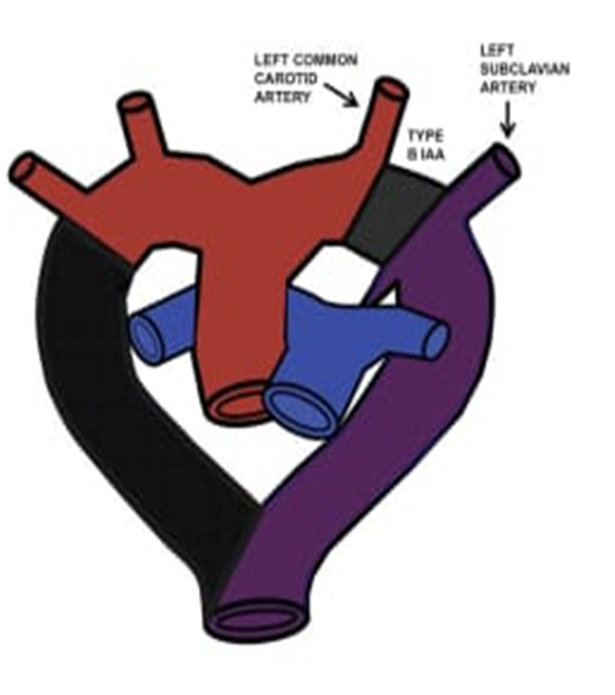
Presentation similar to coarctation.
Normal upper arm blood pressure and pulse
Decreased Pulse and Blood pressure in the extremity
Normal spo2 in Upper limb. Decreased in lower limb
Blood pressure discrepancy in right and left arm.
Left arm lower saturation than right

Slide 51
When to suspect in neonates
Acynotic neonate who initially appears well, but suddenly becomes ill when ductus arteriosus closes.
Type B – y sign. The ascending aorta proceeds directly into neck and divides into subclavian artery and common carotid artery

Slide 52
When to suspect in adults
Secondary hypertension
Blood pressure discrepancy in upper and lower limb
Collaterals supplying descending aorta

Slide 53
Diagnosis and management
Fetal echocardiography of 2D and Doppler- interruption of aortic arch .
It is fatal without intervention.
Death within 11 days.

Slide 54
Patient to be started on PGE1 infusion – maintains patency of arterial duct
Inotropic support and mechanical ventilation.
Avoid oral feeds- may precipitate necrotizing enterocolitis
Correction of associated anomaly- VSD
Single staged repair- arterial duct is ligated, aorta mobilized. Ascending aorta connected to descending aorta via graft.

Slide 55
Pulmonary artery sling
Left pulmonary artery arises from right pulmonary artery instead of pulmonary trunk.
It courses between esophagus and trachea
Association”:
1)Tracheal stenosis and
2)Maldevelopment of bronchial tree.

Slide 56
In type IIA, the bridging bronchus originates from the left main bronchus and supplies the right middle and upper lobe
Type IIB is defined by a complete absence of the right bronchial tree, with the right lung being supplied by a bridging bronchus from the left mainstem bronchus. The right lung is commonly hypoplastic

Slide 57
Male predominance
Association:
CARDIAC NON CARDIAC
ASD Imperforate anus
VSD Esophageal atresia
Persistent left superior vena cava
TOF

Slide 58
Predominantly respiratory symptoms
Related to compression of trachea and abnormal development of bronchial tree
Diagnosis is incidental or present in adolescent or adulthood with respiratory symptoms

Slide 60
management
Surgical intervention
Anastomosis of left pulmonary artery to pulmonary trunk and tracheoplasty
Pulmonary artery sling is frequently associated with complete cartilaginous tracheal ring
Therefore patients should have careful airway assessment

Slide 61
Innominate artery compression syndrome

Slide 62
incidence
Rare malformations
1-3% of congenital heart disease
Males have 2 X risk
Published reports are primarily observational studies of patients treated with surgical repair at the tertiary centre
(symptomatic cases forms the majority of reported case)

Slide 63
Relative frequency of different malformations:
Right aortic arch and aberrant subclavian artery and left sided ductus arteriosus – 30-60 %
Double aortic arch- 30-45%
Innominate artery compression syndrome- 3-20%
Aberrant left subclavian- 3-7%
Pulmonary artery sling- less than 5 %

Slide 64
Presenting symptoms
1)ESOPHAGEAL COMPRESSION:
DYSPHAGIA
VOMITING
2)TRACHEAL COMPRESSION:
STRIDOR
RESPIRATORY INFECTIONS
RESPIRATORY DISTRESS
WHEEZING
COUGH

Slide 65
Double aortic arches may present earlier than other forms of vascular ring,in first few weeks of life
Pulmonary artery sling and interrupted aortic arch may present immediately after life.
Patients with incomplete vascular rings are asymptomatic.

Slide 66
Associated anomalies
Cardiac lesions: Non cardiac lesions:
Ventricular septal defect 1)Tracheo-esophageal fistula
Tetrology of fallot 2)Cleft lip-palate
Coarctation of aorta 3)Sub glottic stenosis
PDA 4)Di-George, Downs syndrome and Charge syndrome

Slide 67
Physical examination
Infants posture– arched back and extended neck.
Noisy breathing- associated tracheobronchomalacia
Stridor and Ronchi that worsens with agitation
Nasal flaring
Intercoastal retraction
Tachypnea
Intermittent cyanosis

Slide 68
diagnosis
High index of suspicion
Chest xray Posterior , Anterior and Lateral views
(magnified high kilovoltage airway films)
Also rules out other causes

Slide 70
The next sequence of diagnostic modality depends on
Cost
Local expertise
Avaliable technology

Slide 71
Computed tomography or magnetic resonance angiography
3 dimensional visualization of vascular anatomy- detailed anatomical information for planning surgery
CTA- Minimal radiation and quicker study
MRA- No radiation, image acquisition is longer and sedation required

Slide 72
echocardiography
Complementary procedure- can detect associated cardiac lesions
Non invasive , readily available , no radiation
Cannot detect atretic segments and poorly visualize the airways

Slide 73
Bronchoscopy
Identify other cause of respiratory obstruction
Determines only the level of obstruction
Invasive procedure- worsens tracheal edema
Used for preop assessment for ET intubation

Slide 74
Barium swallow
Not used
Posterior indentation of esophagus in all vascular rings
Pulmonary sling shows anterior indentation and increased space between trachea and esophagus

Slide 75
approach
Chest xray Evaluate pulmonary pathology and sidedness of aortic arch
Echocardiogram Arch Branching pattern and intra cardiac anatomy
CTA Define vascular anatomy

Slide 76
Antenatal diagnosis
3-vessel and trachea and supra aortic branch views
Should be confirmed after delivery

Slide 77
DD
Tracheo esophageal fistula
Asthma
GERD
Recurrent pneumonia
External compression of trachea by mediastinal mass

Slide 78
treatment
The only definitive treatment is surgery
Excellent surgical outcomes- low risk of morbidity and rarer risk of death
Surgery – symptomatic patients
No role for pharmacological treatment- Symptoms caused by mechanical compression

Slide 79
Vascular ring- release of vascular and ligamentous structure around trachea
Aberrant retroesophageal structure reimplanted to a more usual location
Double aortic arch- Surgical division of the smaller/atretic arch.( usually left) along with ductus or ligamentum.
approach via left thoracotomy

Slide 80
Right aortic arch with aberrant left subclavian artery and left ductus-
surgical approach via left thoracotomy and ductus/ligamentum identified and divided. Resection of the diverticulum of kommerell and reimplantation of aberrant left subclavian into left common carotid.
Pulmonary artery sling-
Left pulmonary artery relocated from its right sided origin to the main pulmonary artery, anterior to trachea. Tracheoplasty if there is complete tracheal rings

Slide 81
Clinical outcomes is excellent in patients who undergo correction
Patients with associated tracheomalacia and other anomalies may continue to have respiratory symptoms after birth
For patients with symptomatic vascular ring surgical correction is recommended.
Surgical correction is not required in asymptomatic patients who are incidentally diagnosed with vascular rings.

Slide 82
Thank you

